Slide 1


Automated Algorithm Design VIP
Part 1 - Genetic Algorithm

Slide 2
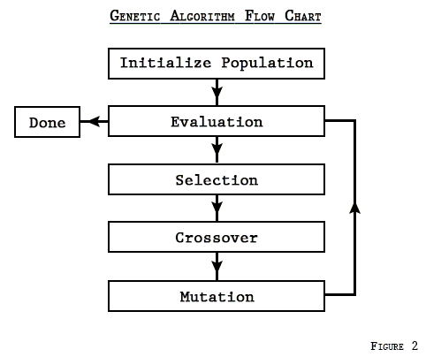
Concept
With genetic algorithms, each new generation is created through mating/mutation of individuals in the previous population (then their fitness is evaluated). Through numerous operations of this process, it will eventually produce the best individual - one whose fitness is better than everyone else’s in the population and cannot get any better.

Slide 3
Genetic Algorithm - Keywords
Individual
Population
Objective
Fitness
Evaluate
Selection
Mate / Crossover
Mutate
Algorithms (various evolutionary algorithms)

Slide 4
Genetic Algorithm - Keywords (cont.)
Individual: one specific candidate in the population (with properties such as DNA)
Population: group of individuals whose properties will be altered
Objective: a value used to characterize individuals that you are trying to maximize or minimize (usually the goal is to increase objective through the evolutionary algorithm)
Fitness: relative comparison to other individuals; how well does the individual accomplish a task relative to the rest of the population?
Evaluation: a function that computes the objective of an individual

Slide 5
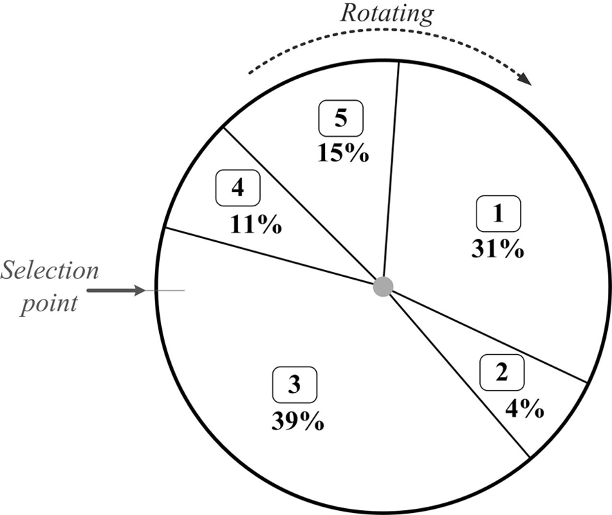
Genetic Algorithm - Keywords (cont.)
Selection: represents ‘survival of the fittest’; gives preference to better individuals, therefore allowing them to pass on their genes
Fitness Proportionate: the greater the fitness value, the higher the probability of being selected for mating
Tournament: several tournaments among individuals (number of individuals in each tournament is dependent on tournament size); winners are selected for mating

Slide 6
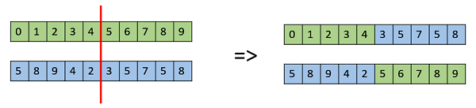
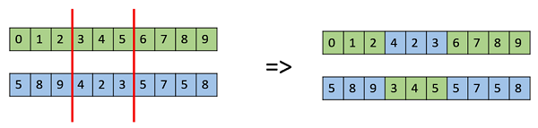
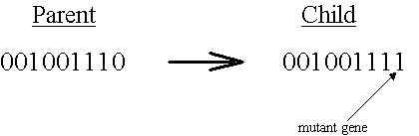
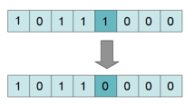
Genetic Algorithm - Keywords (cont.)
Mate/Crossover: represents mating between individuals
Mutate: introduces random modifications; purpose is to maintain diversity
Single Point
Double Point

Slide 7
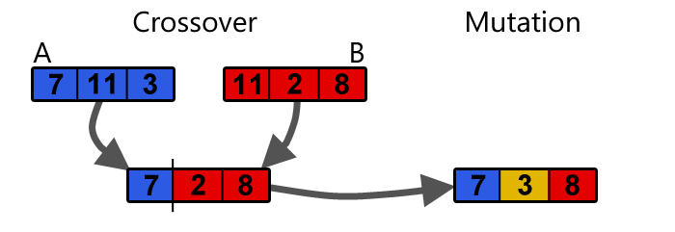
Genetic Algorithm - Keywords (cont.)

Slide 8
Genetic Algorithm - Keywords (cont.)
Algorithms: various evolutionary algorithms to create a solution or best individual
Randomly initialize population
Determine fitness of population
Repeat…
select parents from population
perform crossover on parents creating population
perform mutation of population
determine fitness of population
… until best individual is good enough.
*https://www.doc.ic.ac.uk/~nd/surprise_96/journal/vol1/hmw/article1.html

Slide 9
One Max Problem - Example
This problem begins with individuals that each has a list of one hundred values that are either 0 or 1.
The goal is to eventually produce an individual whose list contains ALL one’s.
[0, 0, 1, 1, 1, 0, 1, 1, 0, 1, 1, 1, 1, 1, 1, 1, 1, 1, 1, 1, 1, 1, 0, 1, 1, 1, 1, 1, 0, 0, 0, 1, 1, 1, 1, 1, 1, 0, 0, 1, 1, 1, 0, 1, 1, 0, 1, 1, 1, 0, 1, 1, 1, 1, 1, 0, 0, 0, 0, 1, 1, 1, 1, 0, 0, 1, 1, 1, 0, 1, 0, 0, 1, 1, 0, 1, 1, 0, 1, 1, 1, 0, 1, 0, 1, 0, 1, 1, 1, 0, 1, 0, 1, 1, 0, 1, 0, 0, 1, 1] (68.0) = 68 one’s = objective value
[1, 1, 1, 1, 1, 1, 1, 1, 1, 1, 1, 1, 1, 1, 1, 1, 1, 1, 1, 1, 1, 1, 1, 1, 1, 1, 1, 1, 1, 1, 1, 1, 1, 1, 1, 1, 1, 1, 1, 1, 1, 1, 1, 1, 1, 1, 1, 1, 1, 1, 1, 1, 1, 1, 1, 1, 1, 1, 1, 1, 1, 1, 1, 1, 1, 1, 1, 1, 1, 1, 1, 1, 1, 1, 1, 1, 1, 1, 1, 1, 1, 1, 1, 1, 1, 1, 1, 1, 1, 1, 1, 1, 1, 1, 1, 1, 1, 1, 1, 1] (100.0) = 100 one’s = objective value

Slide 10
One Max Problem - Example Output
------------------------------------------------------------ Generation 3 ------------------------------------------------------------
Evaluated 167 individuals
Min. 47.0
Max. 71.0
Avg. 62.96
Std. 2.907
Best individual is [1, 1, 0, 1, 1, 1, 1, 1, 1, 1, 1, 0, 0, 1, 1, 1, 1, 1, 0, 1, 0, 1, 0, 1, 0, 1, 0, 0, 1, 0, 1, 0, 1, 1, 1, 0, 1, 1, 1, 1, 1, 1, 0, 1, 1, 0, 1, 1, 1, 0, 1, 1, 1, 1, 1, 1, 1, 1, 1, 0, 0, 1, 0, 0, 0, 1, 1, 0, 1, 1, 1, 1, 1, 1, 0, 0, 0, 1, 0, 1, 1, 1, 1, 0, 1, 1, 1, 1, 1, 0, 0, 1, 1, 0, 1, 1, 1, 1, 1, 1] (71.0)
------------------------------------------------------------ Generation 15 ------------------------------------------------------------
Evaluated 163 individuals
Min. 74.0
Max. 88.0
Avg. 82.68
Std. 2.225
Best individual is [1, 1, 0, 1, 1, 1, 1, 1, 1, 1, 1, 1, 1, 1, 1, 1, 1, 1, 1, 1, 1, 1, 1, 1, 1, 1, 0, 1, 1, 1, 1, 1, 1, 1, 1, 0, 1, 1, 1, 1, 1, 1, 0, 1, 1, 0, 1, 1, 1, 1, 1, 0, 1, 1, 1, 1, 1, 1, 1, 1, 1, 0, 1, 1, 1, 0, 1, 1, 1, 0, 1, 1, 1, 1, 1, 1, 1, 1, 1, 0, 1, 1, 1, 1, 1, 1, 1, 1, 1, 0, 1, 1, 1, 1, 1, 1, 1, 1, 1, 0] (88.0)
------------------------------------------------------------ Generation 7 ------------------------------------------------------------
Evaluated 171 individuals
Min. 62.0
Max. 76.0
Avg. 70.89
Std. 2.446
Best individual is [1, 1, 0, 1, 1, 1, 1, 1, 1, 1, 1, 0, 0, 1, 1, 1, 1, 1, 0, 1, 0, 1, 1, 1, 1, 1, 0, 1, 1, 1, 1, 1, 1, 1, 1, 0, 1, 1, 1, 1, 1, 1, 0, 1, 1, 0, 1, 1, 1, 0, 1, 1, 1, 1, 1, 1, 1, 1, 1, 0, 0, 1, 0, 0, 0, 1, 1, 0, 1, 1, 1, 1, 1, 1, 0, 0, 0, 1, 0, 1, 1, 1, 1, 0, 1, 1, 1, 1, 1, 0, 0, 1, 1, 0, 1, 1, 1, 1, 1, 1] (76.0)
------------------------------------------------------------ Generation 22 ------------------------------------------------------------
Evaluated 187 individuals
Min. 80.0
Max. 92.0
Avg. 88.37
Std. 2.201
Best individual is [1, 1, 0, 1, 1, 1, 1, 1, 1, 1, 1, 1, 1, 1, 1, 1, 1, 1, 1, 1, 1, 1, 1, 1, 1, 1, 1, 1, 1, 1, 0, 1, 1, 1, 1, 1, 1, 1, 0, 1, 1, 1, 1, 1, 1, 1, 1, 1, 1, 1, 1, 1, 1, 1, 1, 1, 1, 1, 1, 0, 0, 1, 1, 1, 1, 1, 1, 1, 1, 1, 1, 1, 1, 1, 1, 1, 1, 1, 1, 0, 1, 1, 1, 1, 0, 1, 1, 1, 1, 1, 1, 1, 1, 0, 1, 1, 1, 1, 1, 1] (92.0)
------------------------------------------------------------ Generation 11 ------------------------------------------------------------
Evaluated 171 individuals
Min. 69.0
Max. 84.0
Avg. 77.18
Std. 2.558
Best individual is [1, 1, 0, 1, 0, 1, 1, 1, 1, 1, 1, 1, 0, 1, 1, 1, 1, 1, 1, 1, 1, 1, 1, 1, 1, 1, 0, 1, 1, 1, 1, 1, 1, 1, 1, 0, 1, 1, 1, 1, 1, 1, 0, 1, 1, 0, 1, 1, 1, 1, 1, 0, 1, 1, 1, 1, 1, 1, 1, 1, 1, 0, 1, 1, 1, 0, 1, 1, 1, 0, 1, 1, 1, 1, 1, 1, 0, 0, 1, 1, 1, 1, 1, 1, 1, 1, 1, 1, 1, 0, 0, 1, 1, 0, 1, 1, 1, 1, 1, 1] (84.0)
------------------------------------------------------------ Generation 39 ------------------------------------------------------------
Evaluated 180 individuals
Min. 90.0
Max. 100.0
Avg. 98.83
Std. 2.110
Best individual is [1, 1, 1, 1, 1, 1, 1, 1, 1, 1, 1, 1, 1, 1, 1, 1, 1, 1, 1, 1, 1, 1, 1, 1, 1, 1, 1, 1, 1, 1, 1, 1, 1, 1, 1, 1, 1, 1, 1, 1, 1, 1, 1, 1, 1, 1, 1, 1, 1, 1, 1, 1, 1, 1, 1, 1, 1, 1, 1, 1, 1, 1, 1, 1, 1, 1, 1, 1, 1, 1, 1, 1, 1, 1, 1, 1, 1, 1, 1, 1, 1, 1, 1, 1, 1, 1, 1, 1, 1, 1, 1, 1, 1, 1, 1, 1, 1, 1, 1, 1] (100.0)

Slide 11
Next Steps - Genetic Programming

